Slide 1

DATA SCIENCE
Decision Trees

Slide 2
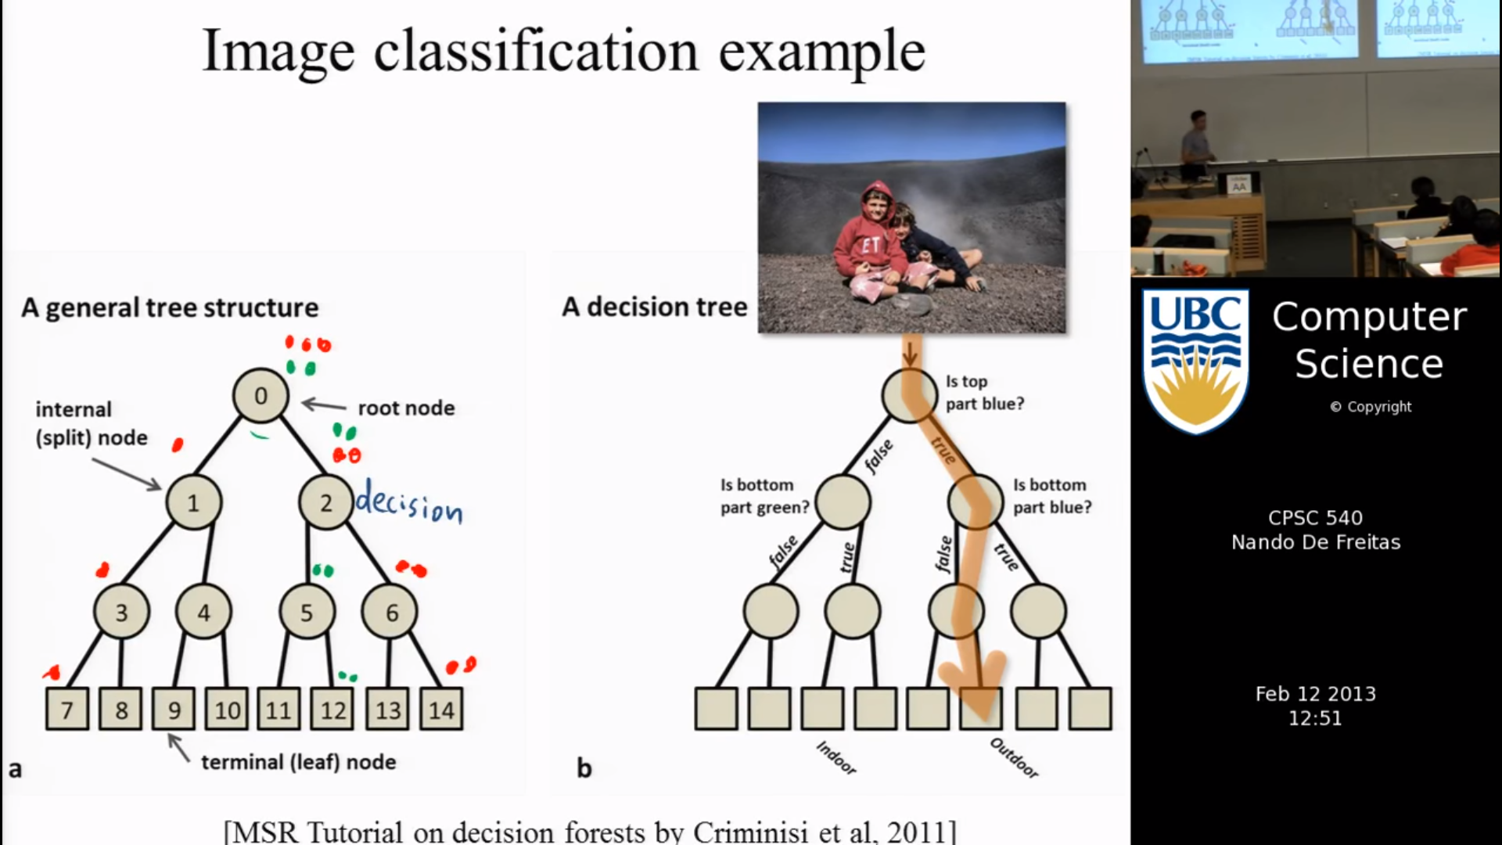
Decision Trees

Slide 3
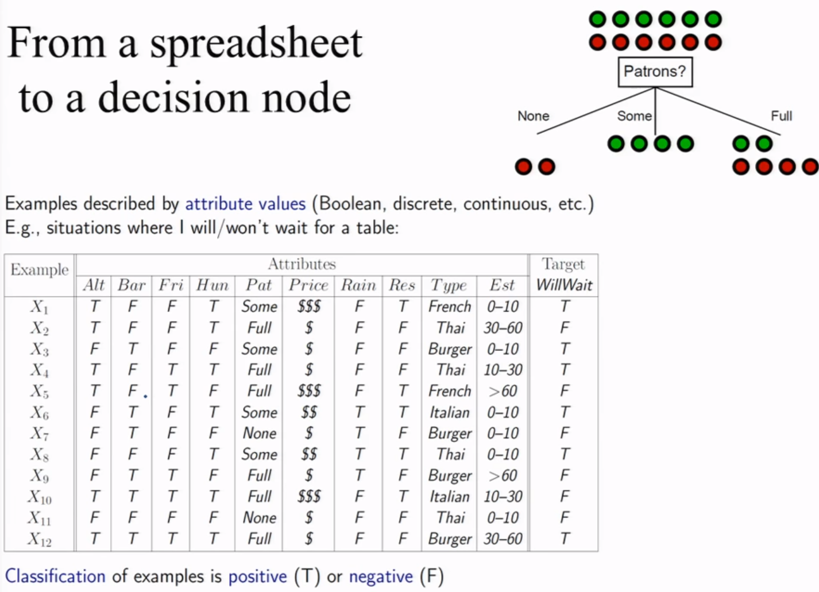

Slide 4
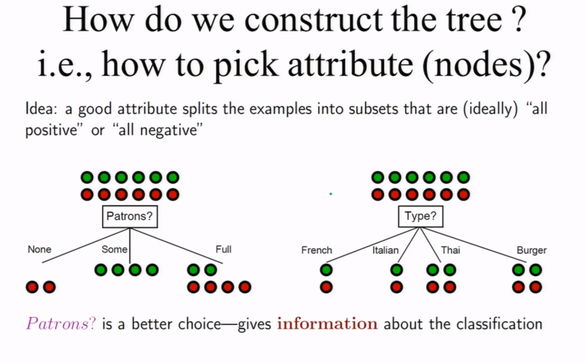

Slide 5
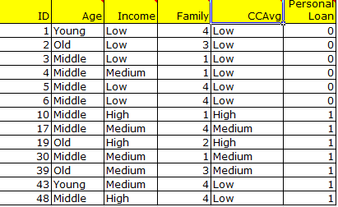
Decision Trees

Slide 6
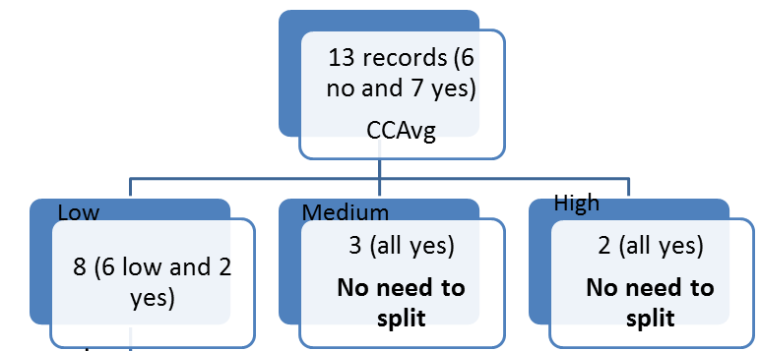
Decision Trees

Slide 7
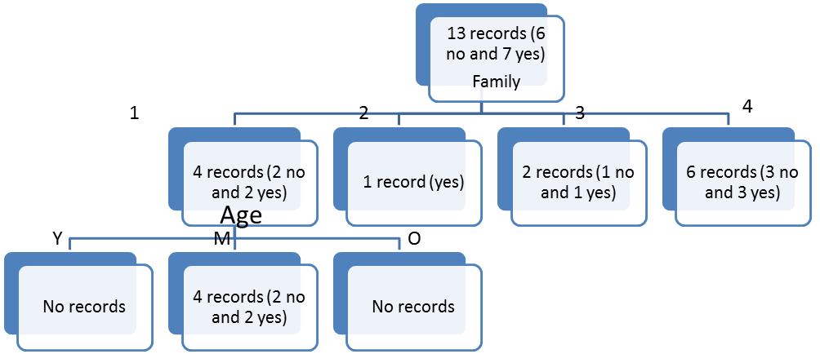
Decision Trees

Slide 8
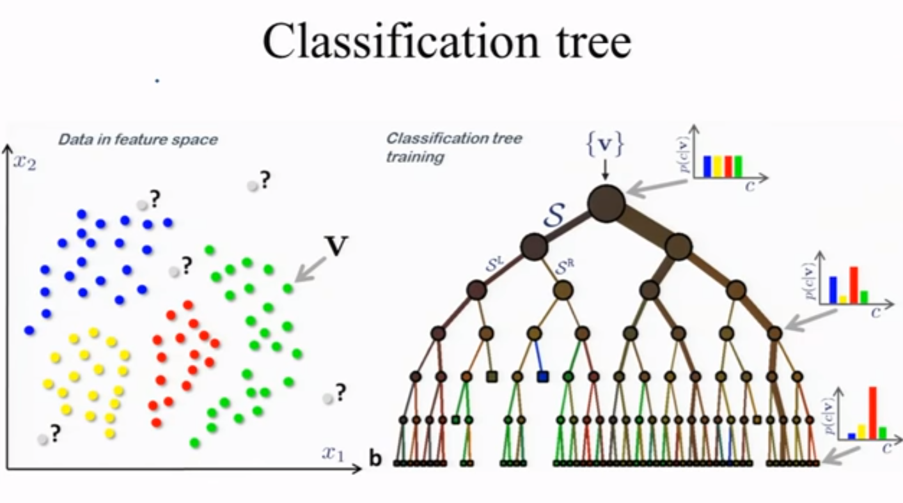

Slide 9
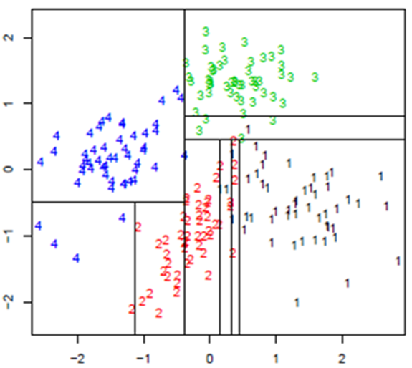
Axis Aligned Splits

Slide 10
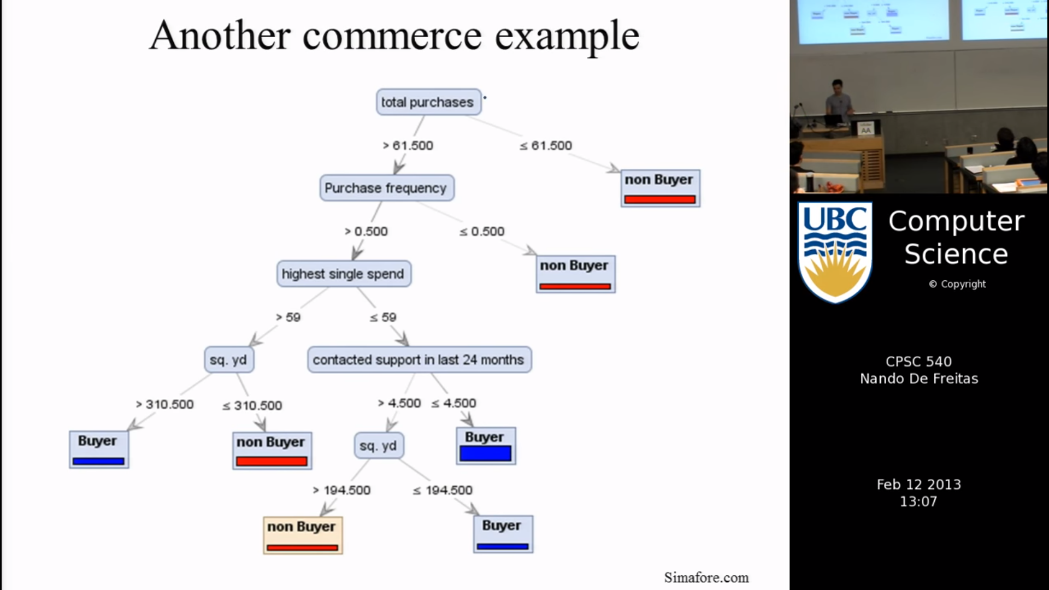

Slide 11

Entropy and Information gain
H = $−\sum_{i}{p_{i}}\log_{2}{p_{i}}$
Information gain = Entropy of the system before split – Entropy of the system after split

Slide 12
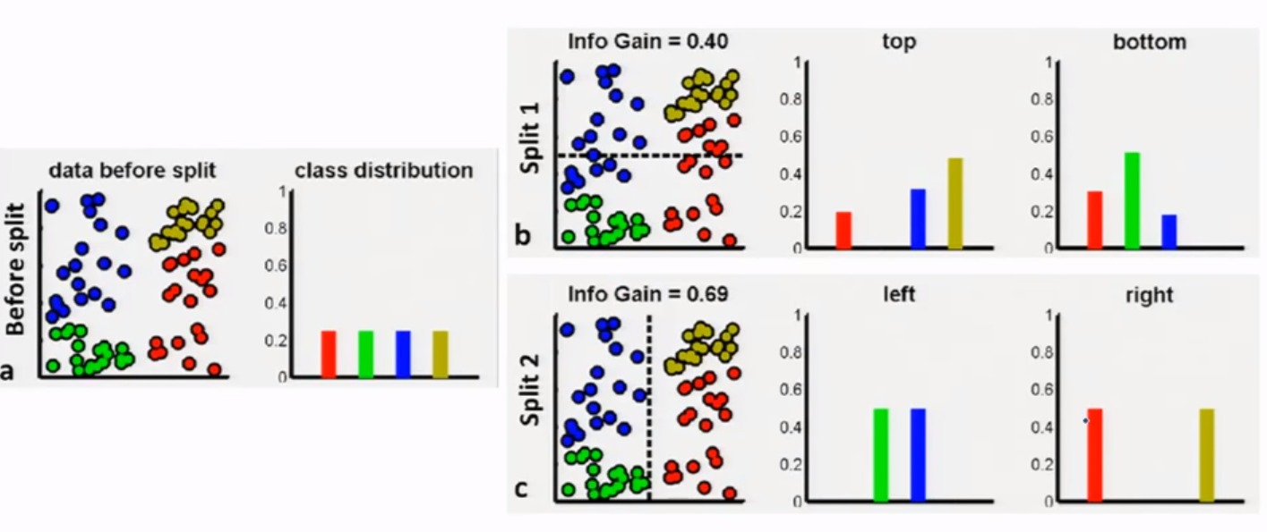
Using Information gain to Split

Slide 13
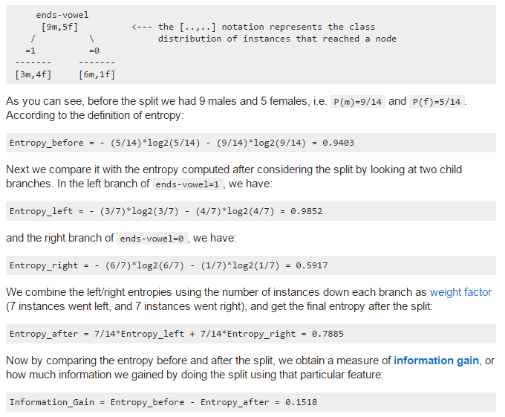

Slide 14
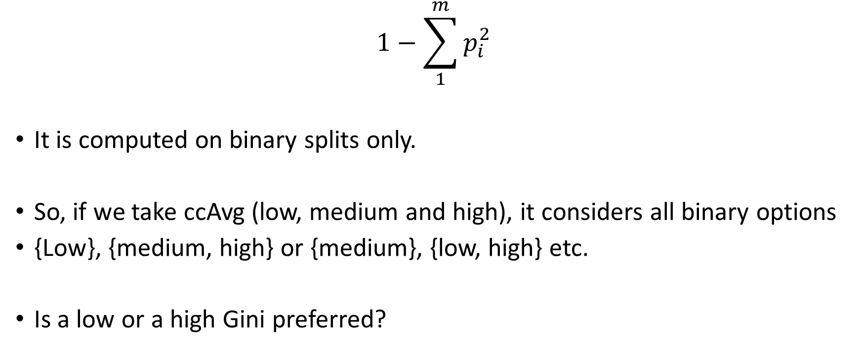
Gini Index
$$1−\sum_{1}^{m}{p_{i}^{2}}$$
It is computed on binary splits only.
So, if we take ccAvg (low, medium and high), it considers all binary options
{Low}, {medium, high} or {medium}, {low, high} etc.
Is a low or a high Gini preferred?

Slide 15
Advantages
Explicability
They are fast
Robust
Requires very little experimentation
You may also build some intuitions about your customer base. E.g. “Are customers with different family sizes truly different?

Slide 16
Can we use a decision tree only for classification or can we use them for predicting a numeric attribute?

Slide 17
Regression Trees
It turns out that, we are collecting very similar records at each leaf. So, we can use median or mean of the records at a leaf as the predictor value for all the new records that obey similar conditions.
Such trees are called regression trees.

Slide 18
Two most popular decision tree algorithms
Implemented in R
CART (Classification and Regression Trees)
Binary split
Gini index
C5.0
Multi split
Info gain

Slide 19
Overfitting in Decision Trees
How do we understand and over come the demon of Overfitting in Decision Trees

Slide 20
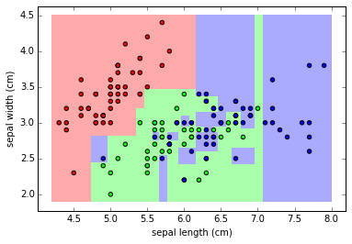

Slide 21

Let’s

